Slide 1
Team 4639 Pre-Season
2016-2017

Slide 2
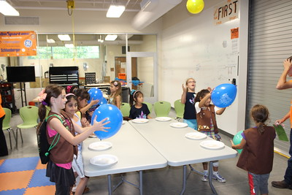
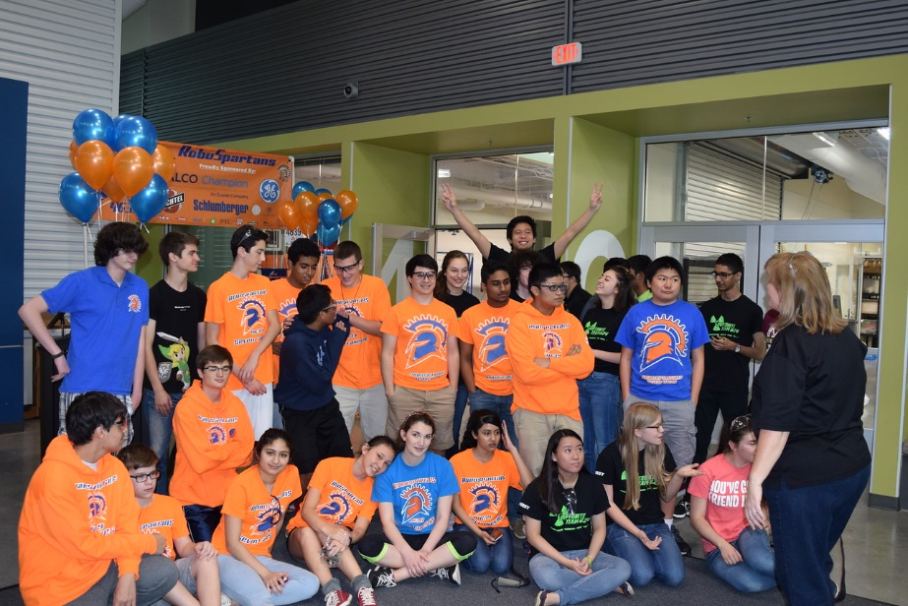
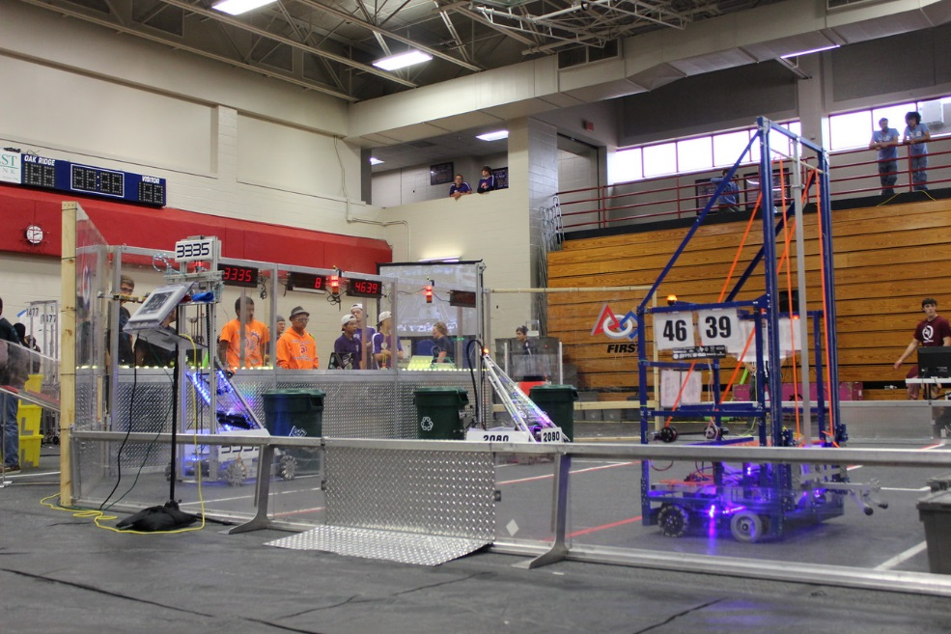
What do we do during Pre-Season?
Hands on Trainings
Off-Season Event(s)
Mock Kickoff
Season Prep
Outreach Events

Slide 3
What BUILD positions are there?
Programming
Electrical
Mechanical
Pneumatics
CAD
Directors:
Winona Menezes (Programming), Reuben Irizarry (Mechanical),
Quinn Fossier (CAD), Carlos Easterbrook?(Electrical).

Slide 4
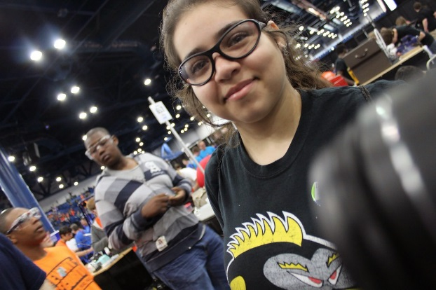
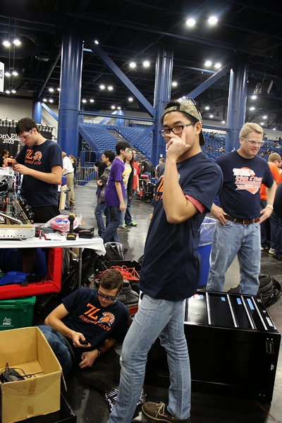
What OUTREACH positions are there?
Webmasters
Chairman’s (Essay Writing)
Business
Marketing (Team Spirit, posters, flyers, etc.)
Media (Photography, Animation, and Videography)
Directors:
???

Slide 5
RSC Etiquette
Be Courteous and respectful to the other teams in the RSC.
Do not eat or drink inside of the work bays, or on the carpet.
Please show up on time for meetings
You can’t enter the RSC without a mentor or KatyISD staff.
Clean up after yourself.

Slide 6
Competition Etiquette
Be Kind and Courteous to other teams, no seat saving or trash talking.
Be aware of your surroundings.
Do NOT crowd the pit, no matter what.
Do not be obnoxious in the crowd. (Don’t bring air horns, scream, stomp the stands, etc.)

Slide 7
What’s the robotics life like?
Build Season
Regionals

Slide 8
What’s in a robot?
Control System
Motors
Motor controllers
Pneumatics
Dreams

