Slide 1
Robot Overview

Slide 2
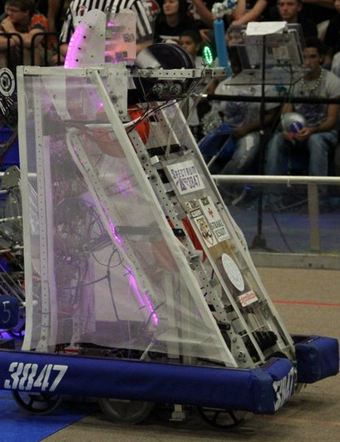
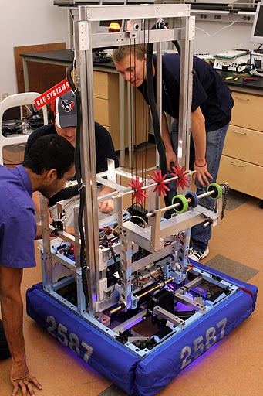
Robots

Slide 3
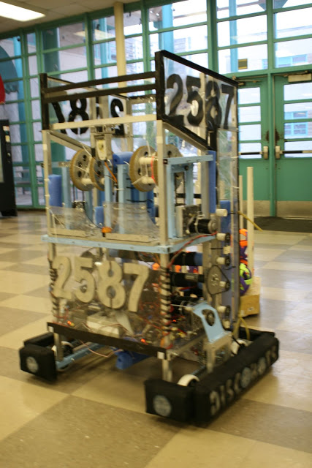
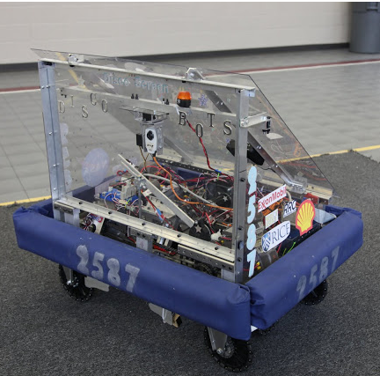
Robots

Slide 4
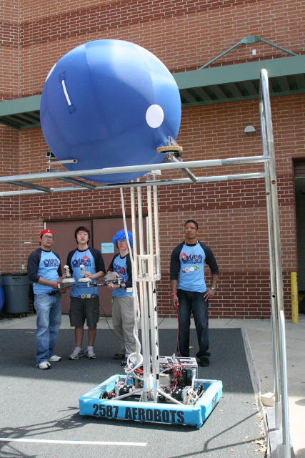
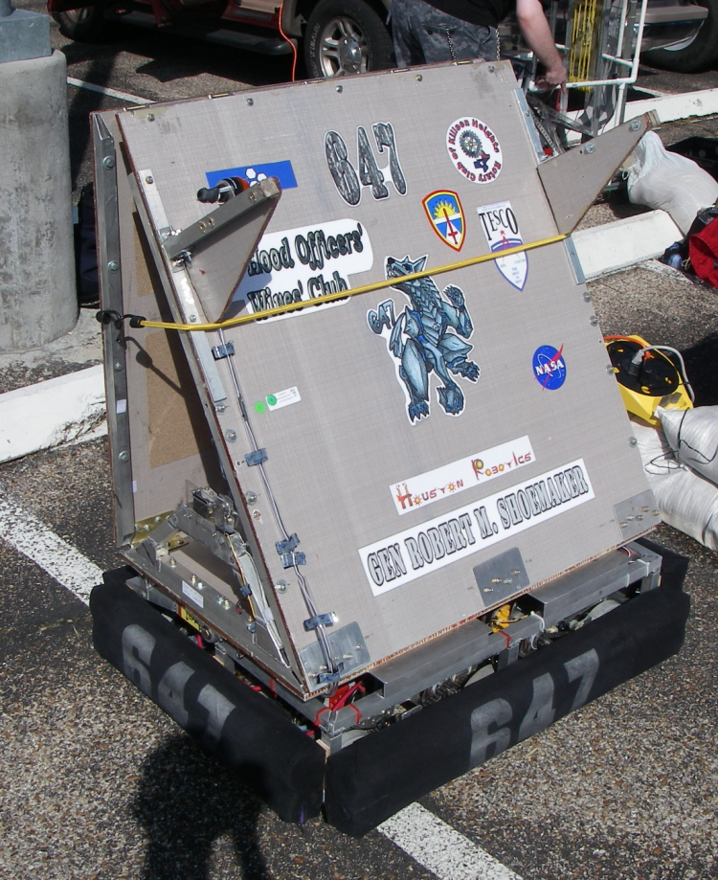
Robots

Slide 5
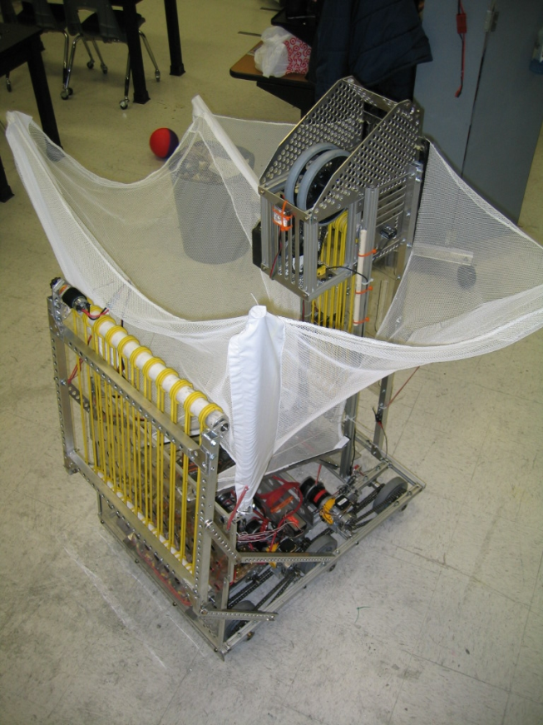
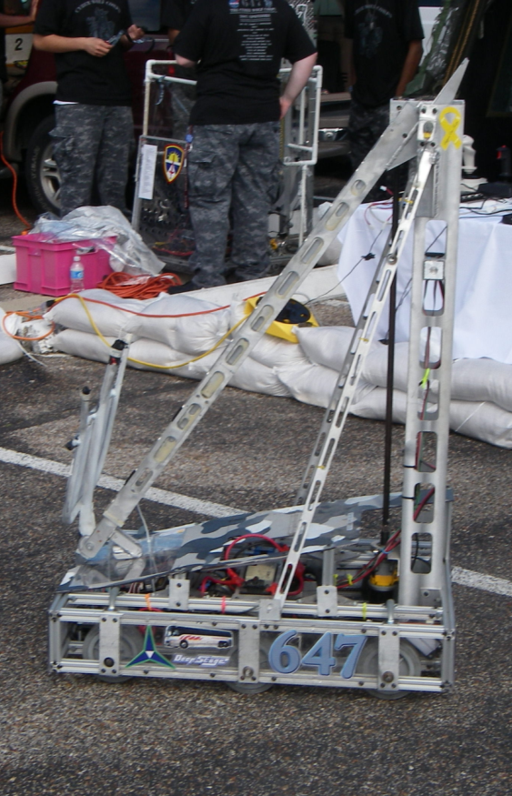
Robots

Slide 6
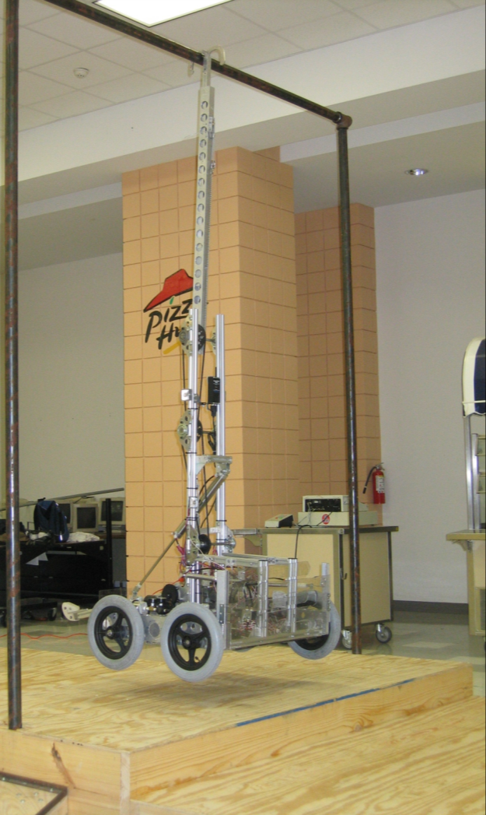
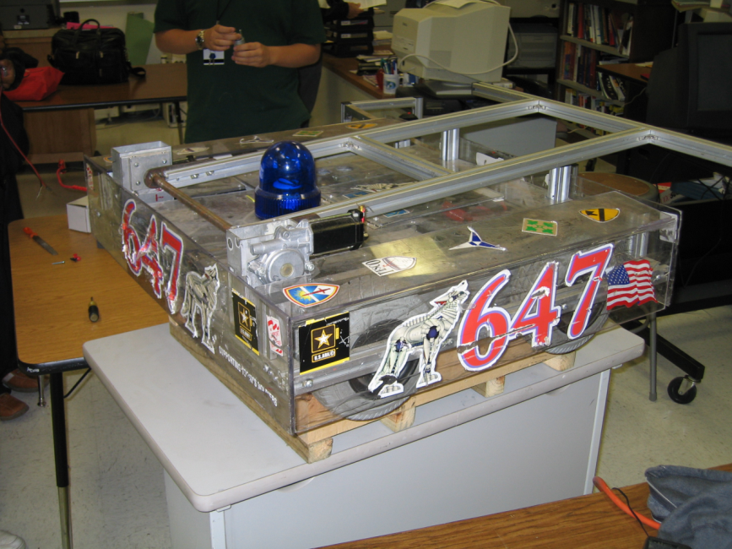
Robots

Slide 7
Every Robot
Must weigh less than 120lbs without battery or bumpers

Slide 8
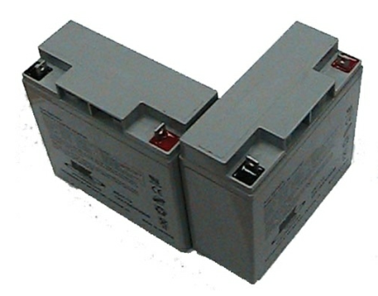
Every Robot
Has one 12 volt battery (10 – 13 lbs)

Slide 9
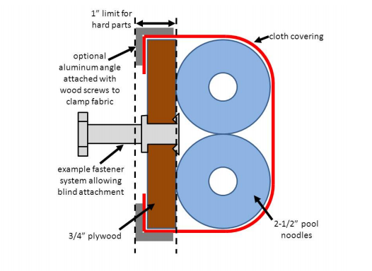
Every Robot
Has bumpers (pool noodles, fabric and wood) (10 – 20lbs)

Slide 10
Total Weight
140-150+ lbs

Slide 11
Dimensions
Have been standard since 2005
38” x 28” x 60” Starting Dimensions
It can be wide or long
Each game has expansion rules, how far and in what directions you can expand from the starting dimensions

Slide 12
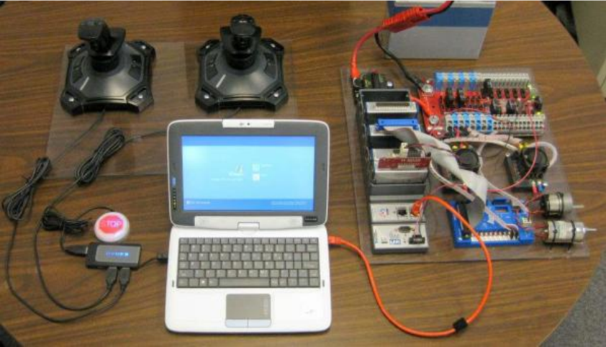
Every Robot
Uses the same control system

Slide 13
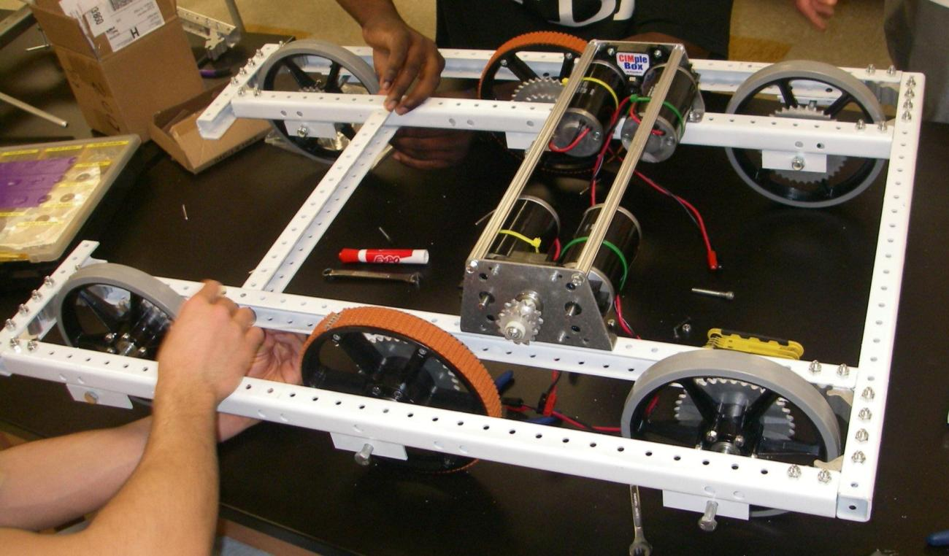
Every Robot
Has a chassis and drive train
Notes:
3847 – 2012 Chassis

Slide 14
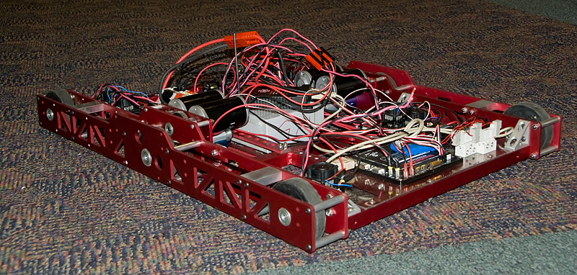
Every Robot
Has a chassis and drive train
Notes:
125 - 2008

Slide 15
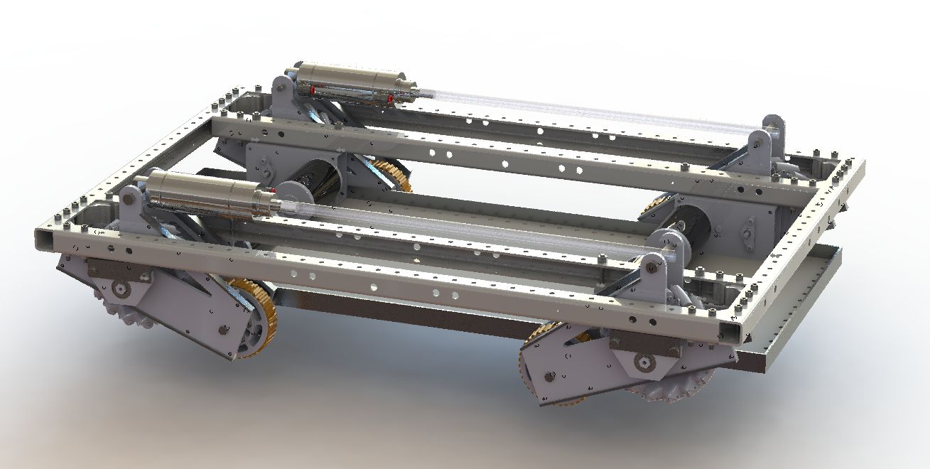
Every Robot
Has a chassis and drive train (some are complicated)
Notes:
125 - 2008

Slide 16
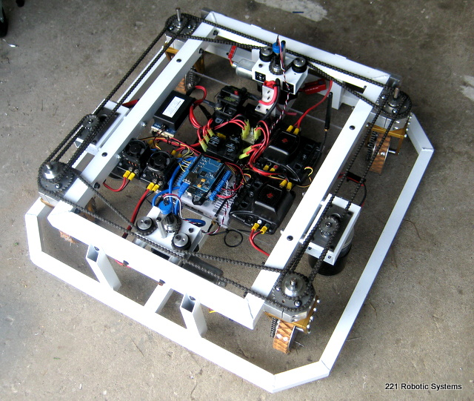
Every Robot
Has a chassis and drive train (some are complicated)
Notes:
125 - 2008

Slide 17
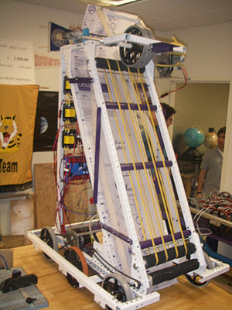
Game Specific
Upper Body
Notes:
3847 – 2012 Ball Rollers

Slide 18
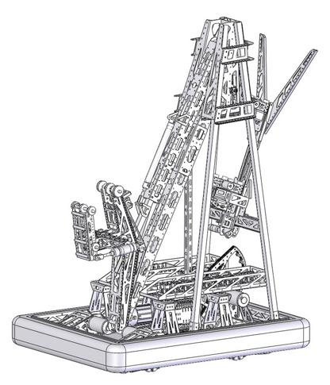
Game Specific
Upper Body
Notes:
148 – 2011 Arm

Slide 19
Game Specific
Upper Body
Notes:
2587 – 2011 Lift

Slide 20
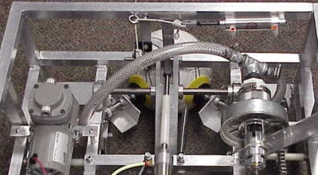
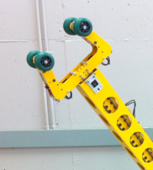
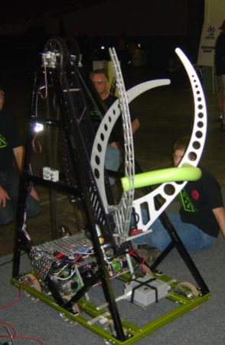
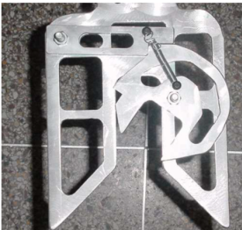
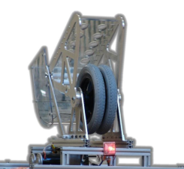
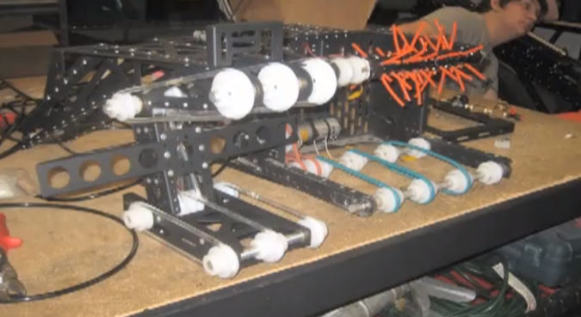
Game Specific
End Effector: “the device at the end of a robotic arm, designed to interact with the environment”
Notes:
Lots of end effectors from different years

Slide 21
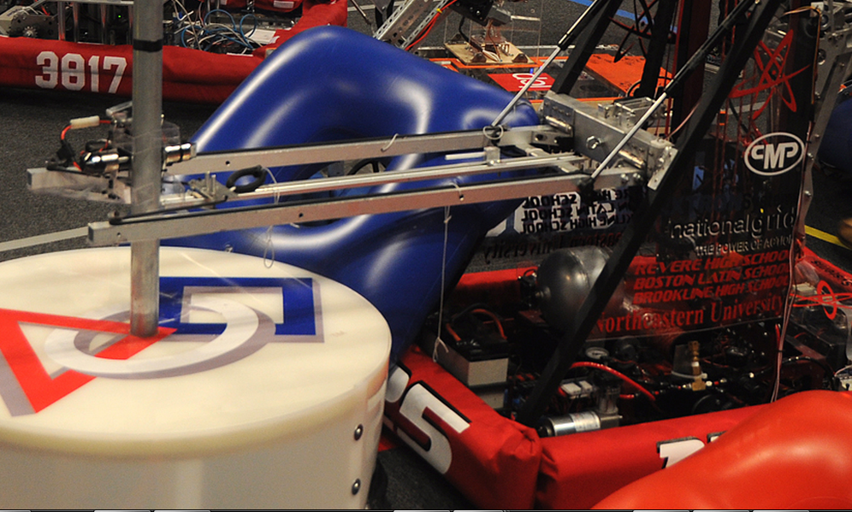
Game Specific
End Game
Notes:
125 – 2011 Minibot deployer

Slide 22
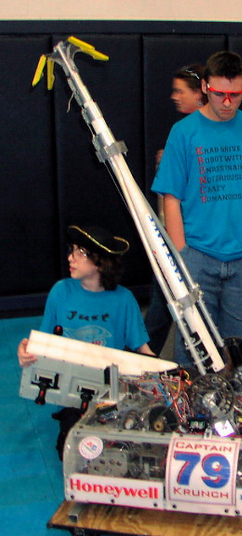
Game Specific
End Game
Notes:
79 – 2004 Hanging Device

Slide 23
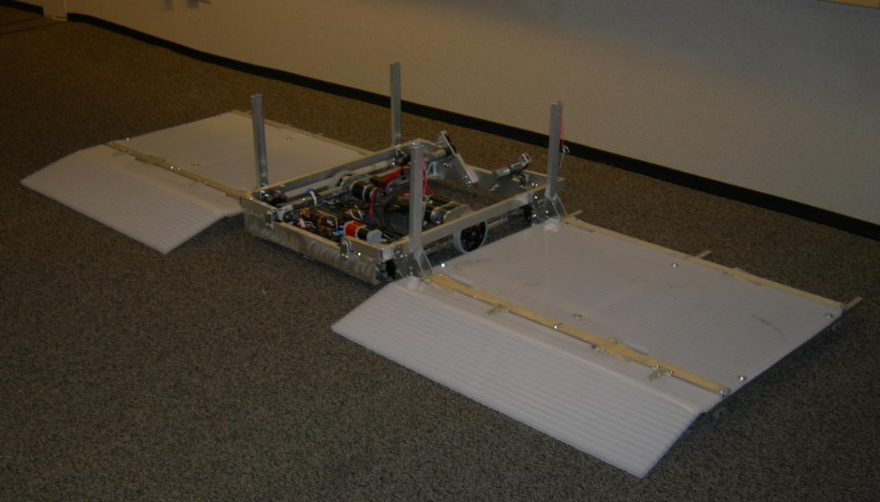
Game Specific
End Game
Notes:
488 – 2007 Ramps to lift other robots

Slide 24
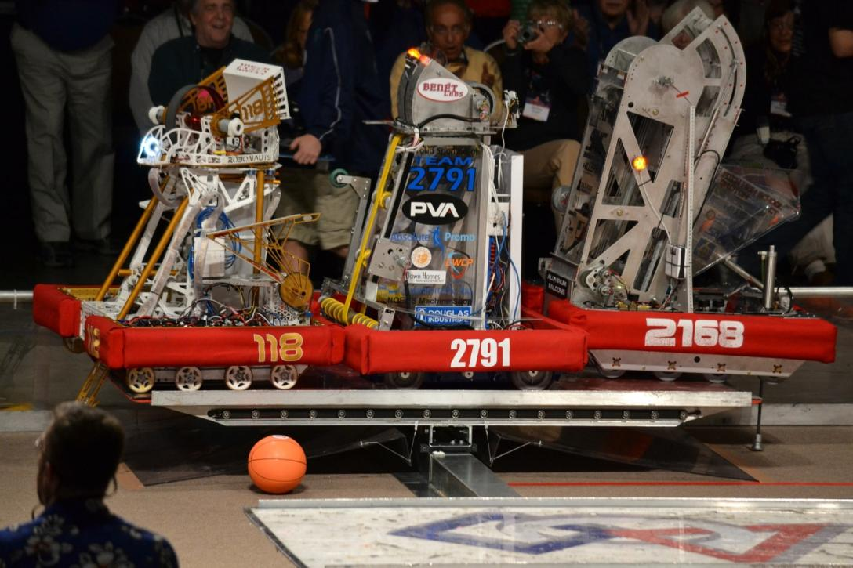
Game Specific
End Game
Notes:
118, 2791, 2168 in 2011 at CT Regional Triple Balance

Slide 25
Basic Sub-teams
Drive Train & Chassis
Upper body (Arm/Lift/Ball Rollers)
End Effector (Claw/Kicker/Shooter)
End Game (Hanger/ramps/stinger)
Controls
Electrical (Wiring)
Pneumatics (Air)
Programming (Code)
CAD (Make it all come together)

Slide 26
Non-Robot Sub-teams
Chairman’s
Scouting/Strategy
Team Support
Awards (Technical Awards)
Spirit
Media & Marketing (Website/Video/Photography)
Logistics (Hours/Food/Transportation/Laundry)

Slide 27
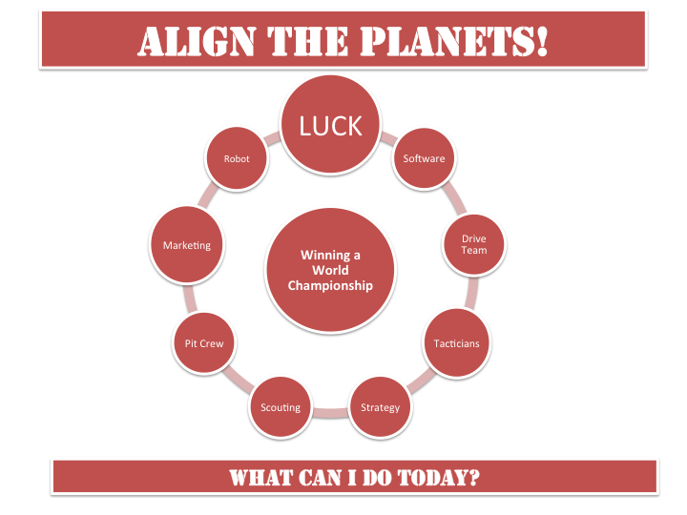
Notes:
JVN’s planet Alignment

