Slide 1
Intro to Drive Trains and Kit Bot Drive

Slide 2
What is a drive train?
Components that work together to move the robot from point A to point B.
Usually also determines many aspects of the robot frame.

Slide 3
MVP (Most Valuable Part)
The best drive train…
is more important than anything else on the robot
meets our strategy goals
can be built with our resources
rarely needs maintenance
can be fixed within 4 minutes
is more important than anything else on the robot

Slide 4
4 Rs or (Rrrr)
Reliable
Reparable
Relevant
Reasonable

Slide 5
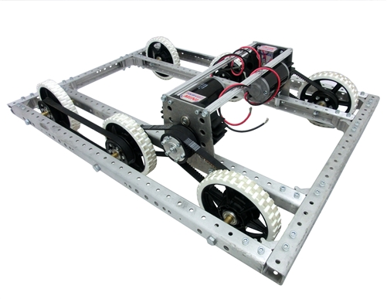
2013 Kit Bot

Slide 6
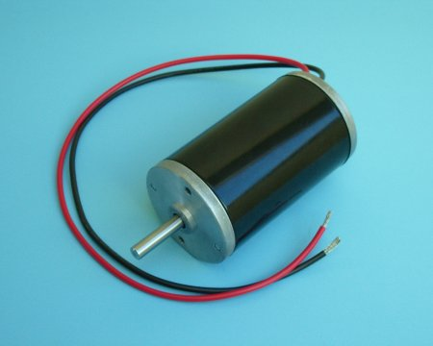
Motors
CIMs
The most common drive motors and the motors you should use at a minimum.
4 CIMs is required if you want to play on Saturday afternoon.

Slide 7
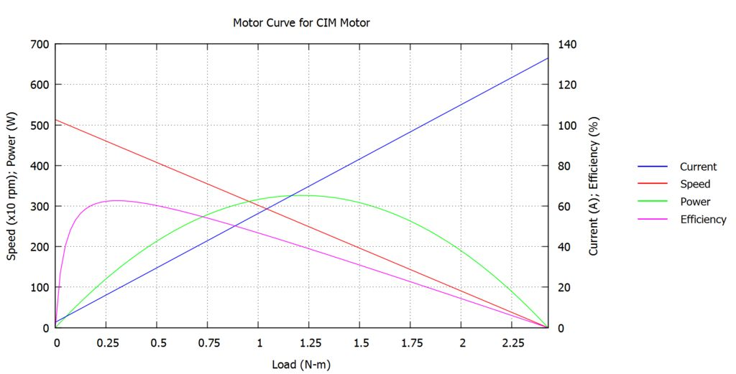
Basics of Motors
Motors are described by their specs
 | Free Speed (RPM) | Stall Torque (N-m) | Stall Current (Amp) | Free Current (Amp) | Power (W) | Current @ Max Power | Power @ 40A
CIM | 5310 | 2.43 | 133.00 | 2.70 | 337.81 | 67.90 | 276.1

Slide 9
Gears
Gearing is used most frequently when attached directly to the motor
Spur Gears
Most common gearing we see in FRC
95-98% efficient per stage
Reverse the direction of
rotation
Ratio =
Number of Driven Teeth
Number of Driving Teeth

Slide 10
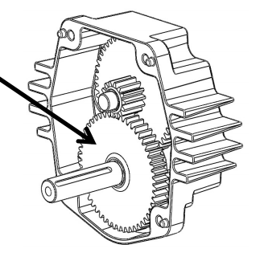
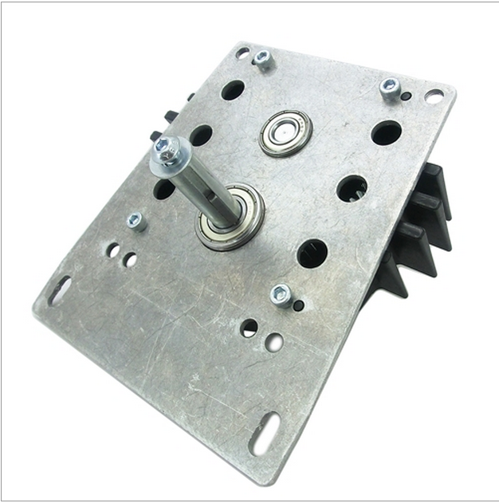
Toughbox Mini

Slide 11
Toughbox Mini
Steel, spur gears, 20 dp, 14.5 degree pressure angle
CIM Gear, 14 tooth
Large Cluster Gear: 50 tooth
Small Cluster Gear: 16 tooth
Large Output Gear: 48 tooth
Output shaft: 1/2 inch diameter, with 1/8" keyway
Weight: 1.95 pounds

Slide 12
Do The Math
Large Gear 1 = 50 Large Gear 2 = 48
CIM Gear = 14 Small Output = 16

Slide 13
Do The Math
Large Gear 1 = 50 Large Gear 2 = 48
CIM Gear = 14 Small Output = 16
Overall Ratio: 10.71:1 (standard)

Slide 14
Let’s build the Gearboxes
http://www.youtube.com/watch?v=uloJ0q3NDx0&feature=youtu.be

Slide 15
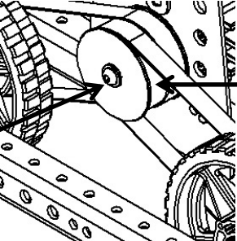
Belts or Chain
Belts and Chain allow you to transfer power over a greater distance than gears
The math is the same but remember the direction doesn’t change

Slide 16
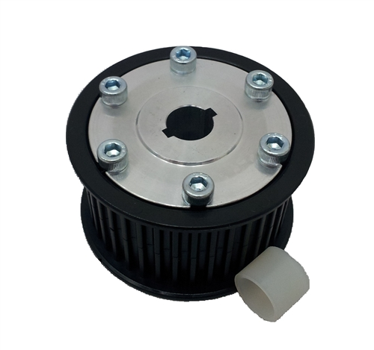
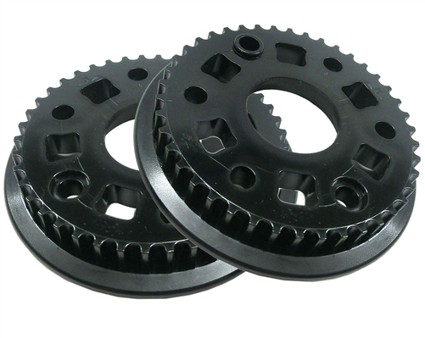
Kit Bot Belts
39 Tooth Gearbox Pulley
42 Tooth Wheel Pulley

Slide 17
More Math
42 / 39 = 1.076
Ratio to the wheel = 10.71:1 * 1.076:1 = 11.52:1
What’s the max theoretical wheel RPM?

Slide 18
More Math
42 / 39 = 1.076
Ratio to the wheel = 10.71:1 * 1.076:1 = 11.52:1
What’s the max theoretical wheel RPM?
HINT: CIM Free Speed = 5310 RPM

Slide 19
More Math
42 / 39 = 1.076
Ratio to the wheel = 10.71:1 * 1.076:1 = 11.52:1
What’s the max theoretical wheel RPM?
5310 / 11.52 = 460.9 RPM

Slide 20
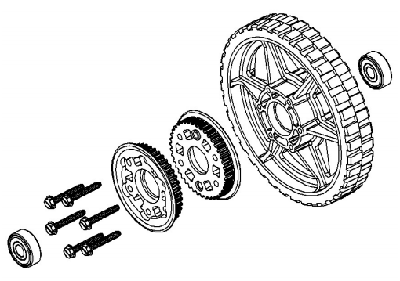
Wheels
The last gear reduction
Small wheels will have less speed and more torque for the same RPM as larger wheels

Slide 21
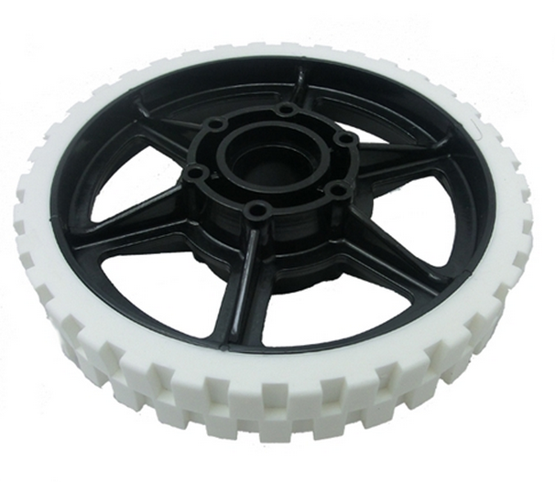
Kit Wheels: AM HiGrip 6”
Diameter = 6 inches
Body Material: Polycarbonate, black
Tread Material: TPU rubber, 77a durometer, natural color (clear)
What is the max speed
of the kitbot?
(Remember 460.9 RPM)

Slide 22
Math
Circumference of the wheel = PI * D
PI * 6 = 18.8495 in
Speed = Circumference * RPM
18.8495 * 460.9 RPM = 8687.7 inches / minute
Converts to about 12 Ft/second

Slide 23
Traction
Friction with a better connotation.
Allows the robot move

Slide 24
Traction
Max Pushing force = Weight * μ
μ = friction coefficient
Normal Force (weight)
Pushing Force
Static friction coefficients
μ = 0.1 = caster (free spinning)
μ = 0.3 = hard plastic
μ = 0.8 = smooth rubber
= 1.0 = sticky rubber
= 1.1 = conveyor treads
Notes:
(plus a little bit because the surfaces aren’t perfectly flat)

Slide 25
Power
Power is determined by the motors in the drive train
Power = Speed X Torque (Rotational Force)
Coefficient of friction limits maximum force of friction because of robot weight limit.

Slide 26
Power Limited Drive
The motors are geared for a max speed
Drive trains are typically “power-limited”
THIS IS BAD
A traction-limited drive train will have the wheels slip against the ground if the robot is driven into a wall.
THIS IS GOOD

Slide 27
Wheel Base
Difference between the distance between your furthest contact points one side vs. distance between the sides of the drive train.
The wider the drive train the easier it is turn
Adding more wheels that are slightly lower allow you to shorten your wheel base

Slide 28
Wheels
Often over looked but they are the last stage of the drive train
A smaller wheel needs less gear reduction to go the same speed (and have the same power)
The tread material and shape is critical to good design
Notes:
The numbers I gave earlier were for 6in wheels so if we had 4in wheels we would go 2/3 the speed.

Slide 29
Drive Types: 2 wheel drive
DrivenWheel
Motor(s)
Motor(s)
+ Easy to design
+ Easy to build
+ Light weight
+ Inexpensive
+ Agile
Not much power
Will not do well on ramps
Less able to hold position
Caster
Notes:
Slide by Andy Baker

Slide 30
Drive Types: 2 wheel drive
DrivenWheel
Motor(s)
Motor(s)
+ Easy to design
+ Easy to build
+ Light weight
+ Inexpensive
+ Agile
Not much power
Will not do well on ramps
Less able to hold position
Caster
Notes:
Slide by Andy Baker

Slide 31
Drive Types: 4 wheel drive, 2 gearboxes
DrivenWheels
Motor(s)
Motor(s)
Chain or belt
+ Easy to design
+ Easy to build
+ Inexpensive
+ Powerful
+ Sturdy and stable
Not agile
Turning is difficult
Adjustments needed
Resource:
Chris Hibner white paper on ChiefDelphi.com
Proves that a wide 4wd drive base can turn easily
DrivenWheels
Notes:
Slide by Andy Baker

Slide 32
Drive Types: 4 wheel drive, 4 gearboxes
DrivenWheels
Motor(s)
Motor(s)
+ Easy to design
+ Easy to build
+ Powerful
+ Sturdy and stable
+ Many options
Mecanum, traction
Heavy
Costly
DrivenWheels
Motor(s)
Motor(s)
Notes:
Slide by Andy Baker

Slide 33
Drive Types: 6 wheel drive, 2 gearboxes
+ Easy to design
+ Easy to build
+ Powerful
+ Stable
+ Agile*
*2 ways to be agile
Lower contact point on center wheel
Omni wheels on front or back or both
This is the GOLD STANDARD in FRC
+ simple
+ easy
+ fast and powerful
+ agile
Gearbox
Gearbox
Heavy **
Expensive **
** - depending on wheel type
Notes:
Slide by Andy Baker

Slide 34
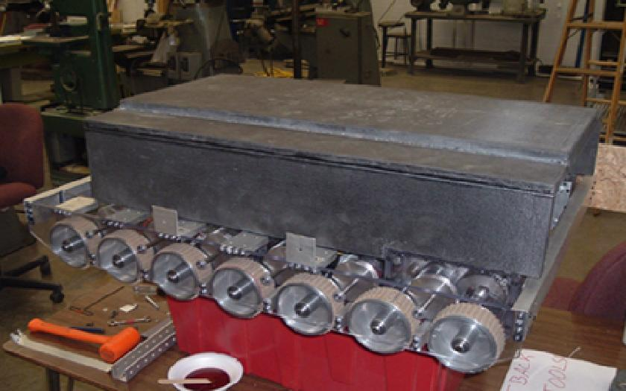
Drive Types: N wheel drive, 2 gearboxes
+ Powerful
+ Stable
+ Agile*
Ability to go over things
Gearbox
Gearbox
HEAVY
EXPENSIVE
*2 ways to be agile
Lower contact point on center wheel
Omni wheels on front or back or both
Notes:
Slide by Andy Baker

Slide 35
Good practices:
Reduce or remove friction almost everywhere you can
Ball Bearings – Video
Proper Alignment
Notes:
Team 488
Friction is a killer it takes away power that could be going to the ground and making your robot go faster or push harder.

Slide 36
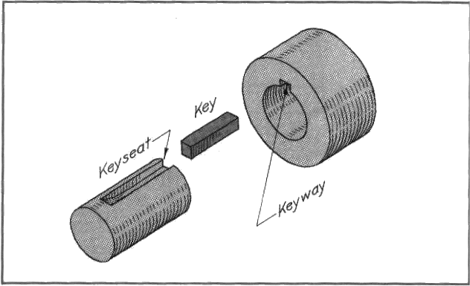
Good practices:
Avoid press fits and friction belting
Use keyway, hex shaft, set screws or some other way to attach things to shafts
Notes:
Team 488
Friction is a killer it takes away power that could be going to the ground and making your robot go faster or push harder.
http://www.me.metu.edu.tr/courses/me114/Lectures/loc_key_spr_riv.htm

Slide 37
Good practices:
Support shafts in two places. No more, no less.
1
2
Notes:
Two places allow their to be a line so the shafts can’t move and cause friction

Slide 38
Good practices:
Avoid long cantilevered loads (West Coast Drive)
Bad
Better
Notes:
Team 488
It puts a lot of force on the shaft supports because of the torque created by the lever

Slide 39
Good practices:
Alignment, alignment, alignment!
Bad
Worse
Notes:
Team 488

Slide 40
More Power
Practical Benefits of Additional Motors
Cooler motors
Decreased current draw; lower chance of tripping breakers
Redundancy
Lower center of gravity
Drawbacks
Heavier
Useful motors unavailable for other mechanisms
Notes:
Thanks 488

Slide 41
Advanced Drive Trains
Holonomic / Omni
Holonmic Omni Wheels / X Drive
H Drive
Mecanum
Crab\Swerve
Tank Treads
Switchable Drive Trains (like transformers)
Octocanum
Nonadrive

Slide 42
Holonomic / X Drive
Omni wheels mounted on the corners
Moves in all direction
Same programming as mecanum
Less torque but more speed than mecanum

Slide 43
H Drive
Needs 5 motors, to have the same forward power as a normal drive train
Takes up more space

Slide 44
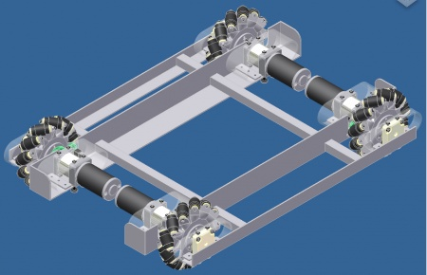
Mecanum
Easy to build omni-direction drive train
4 motors, 4 gearboxes, and 4 Mecanum wheels

Slide 45
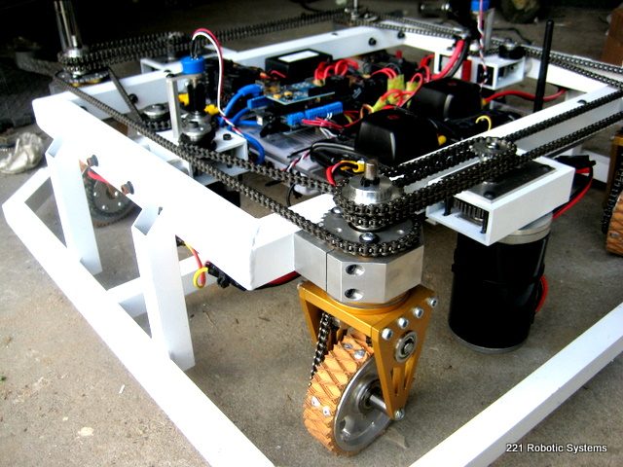
Crab/Swerve
Used interchangeably most of the time
I try to use crab for non-independently steered wheels
Standard traction wheels are all steered to be able to move in different directions

Slide 46
Tank Treads
HEAVY
Harder to make the robot turn well
Get over obstacles easily
(That’s why they use them on real tanks)
In FRC it’s normally just large timing belt
Increased surface area does increase pushing power in some way because of the interaction with the carpet and traction material is better than ideal because they interlock some.

Slide 47
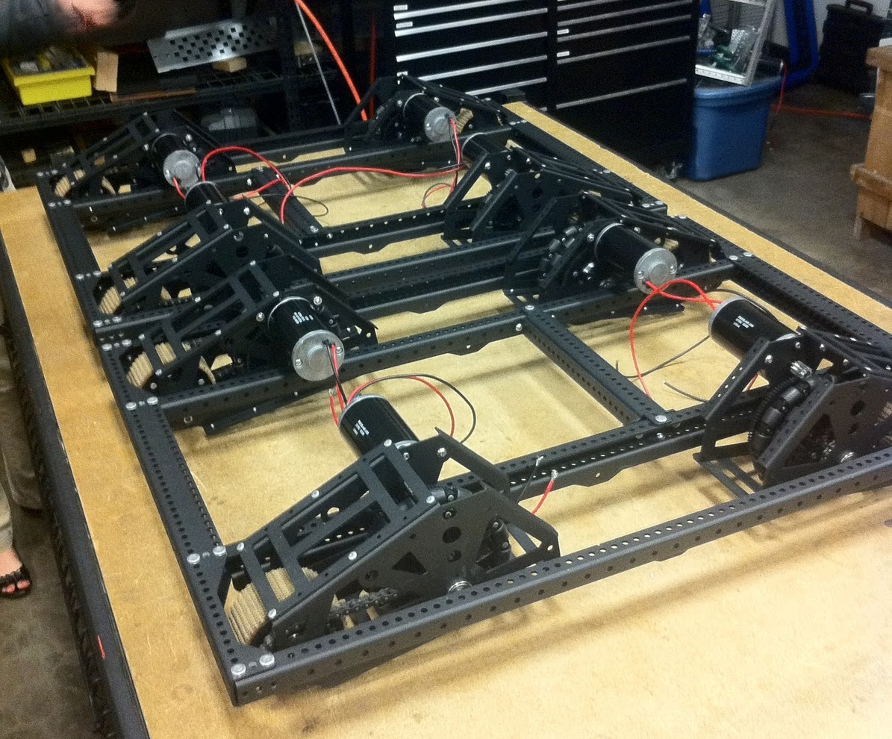
Nonadrive
Swap between H-Drive and Traction Wheels
9 Wheels
148 used this in 2010
They pulled their center wheel
in 2011 and called it
butterfly drive
Missing the Center Wheel ->

Slide 48
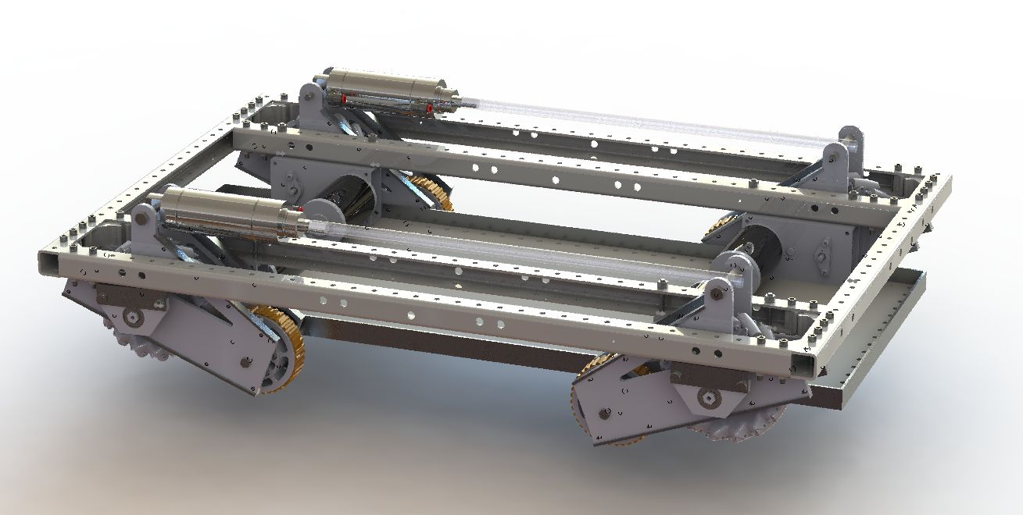
Octocanum
Shift from traction wheels to Mecanum wheels
Pushing power and omni-directional
HEAVY

Slide 49
For More Details
http://first.wpi.edu/Images/CMS/First/2007CON_Drive_Systems_Copioli.pdf

Slide 50
References
http://www.chiefdelphi.com/media/papers/2147
http://files.andymark.com/FIRST-Robotics-Drive-Systems.ppt
http://files.andymark.com/x2010-toughbox-user-guide.pdf
http://www2.usfirst.org/2007comp/other/2007%20Guidelines_Tips_Good%20Practices.pdf

