Slide 1
2015 Electrical Training
Presented by:
Richard Hathcoat
&
Alexander Millan

Slide 2
Agenda
Electricity 101: Current vs. Voltage
Understanding Cable Sizes
FIRST Rules for wiring
Wiring best practices
Wiring termination hands-on practice
Q & A

Slide 3
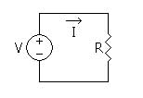
Electricity 101: Current vs. Voltage
Comparisons
Both related to electricity
Voltage, Current, and Resistance – ohms law
V=I/R
Differences
Voltage hurts, but current kills!
In circuits
Series – currents are same, voltage is distributed
Parallel – current is distributed, voltages are same

Slide 4
Electricity 101: Current vs. Voltage (cont’d)
Relationship
Current is the effect as Voltage is the cause
No Current w/o Voltage
Voltage can exist w/o Current

Slide 5
Electricity 101: Current vs. Voltage (cont’d)
Current
What is Current?
Flow of electric charge across an element
Symbol = I
Scenario
Connect a tube to a tank. Now place an obstruction (Resistance) in middle of tube. If the tube is small, then the water flow would be less (less current flow). If the tube is large, then the water flow would be greater (more current flow).

Slide 6
Electricity 101: Current vs. Voltage (cont’d)
Voltage
What is voltage
Potential difference between 2 points
Symbol = V
Types – AC, DC
Scenario
2 water tanks. One half empty, one full. The difference of the water levels in the 2 tanks is similar to voltage difference.

Slide 7
Electricity 101: Current vs. Voltage (cont’d)
Measuring Voltage Video using Multimeter
https://www.youtube.com/watch?v=ZBbgiBU96mM
10.28 to 17 mins
Measuring Current Video using Multimeter
https://www.youtube.com/watch?v=GrgA9hReUHs
7.05 to 11.18 mins

Slide 8
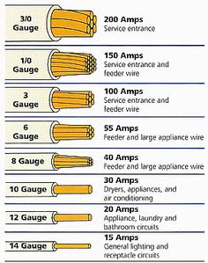
Understanding Cable Sizes
The smaller the gauge #, the larger the wire
Different sizes are used for different applications
Each gauge size can carry a max amount of current
If bundle cables then current rating decreases

Slide 9
Understanding Cable Sizes (cont’d)
“Thin wall” Cable
Thin layer of insulation
Higher grade
Lighter/denser
More resistant to impact damage
Used in aviation
“Tinned” Cable
Looks silver when insulation stripped
Does not corrode as easily
Use heat shrink at end to help prevent corrosion
# of strands in cable
More strands = more flexible
Increased cost

Slide 10
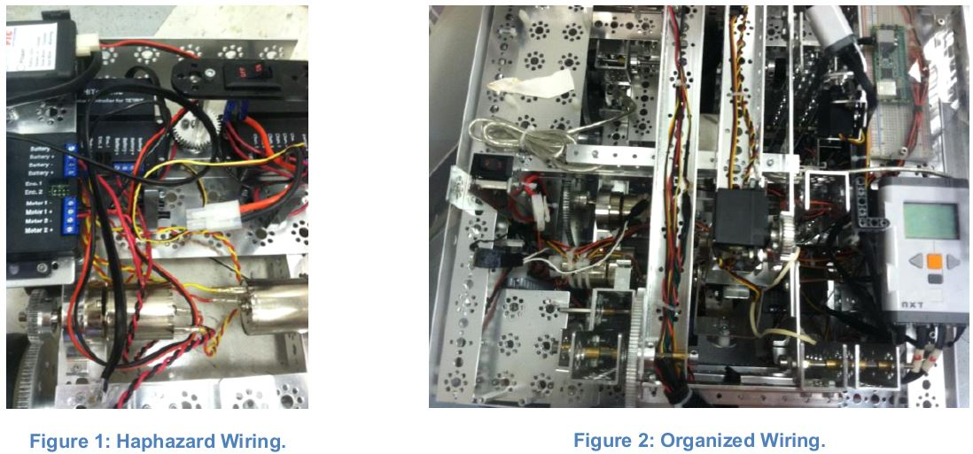
FIRST Rules for wiring
FIRST Rules recommend:
Organized wiring
Tight connections

Slide 11
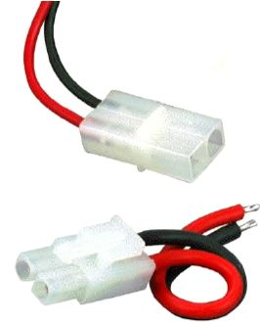
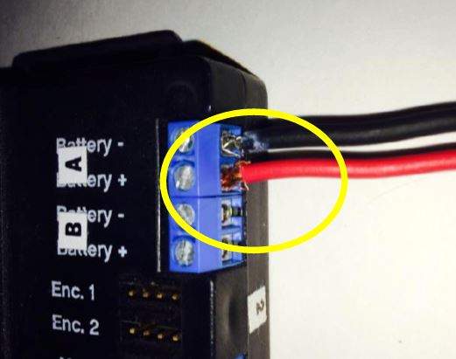
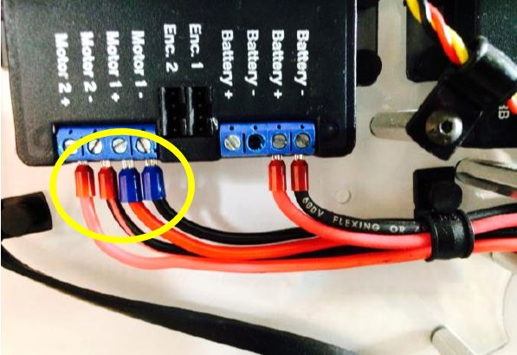
FIRST Rules for wiring (cont’d)
Common Wiring Problems / Solutions
1) Problem: Plug on Tetrix battery not reliable
Solution: replace with quick-disconnect plug
2) Problem: Crimp-on connectors – never use on solid core wire
Solution: Cut tinned section / replace with new blade connector
3) Problem: Screw terminals cause loose connections
Solution: Use Ferrules or End Sleeves to avoid wire strays and a better connection

Slide 12
FIRST Rules for wiring (cont’d)
Proper Wiring Management
Keep wiring stationary
Protect Wiring – use wire loom
Cut cables to correct length

Slide 13
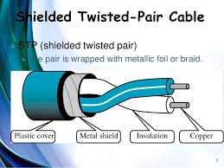
Wiring best practices
Wiring Rules
P.S. & Motor – use shielded twisted pairs
Keep away from signal-carrying wires
<5 feet – use 20 gauge for Motor wiring
>5 feet – use 18 gauge or larger

Slide 14
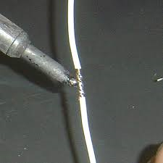
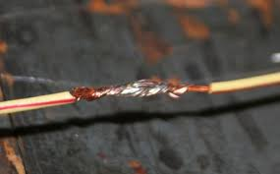
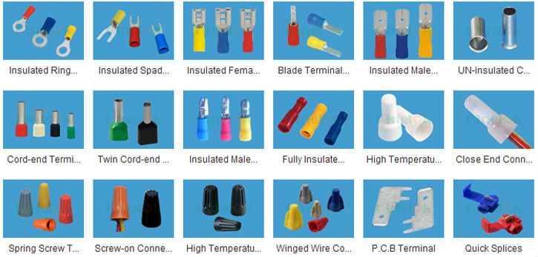
Wiring termination hands-on practice
Termination Types
Solder Type
Strong/solid connection
More reliable
Crimp Type
Quick / simple
Use proper size connector
Use proper crimp tool
Good solder job
Bad solder job

Slide 15
Wiring termination hands-on practice (cont’d)
Hands-on Practice
How to attach 2+ wires together
Find which size termination to use
How to cut off wire insulation
Knowledge check of the basic principles of wiring

Slide 16
Contact Information
Have questions or need help in the future!
Email me at rfhathc3@bechtel.com

Slide 17
QUESTIONS ???

